Slide 1
More OOP! Encapsulation and Examples
Week 6 | Lecture 2 (6.2.1)
While waiting for class to start:
Download and open the Jupyter Notebook (.ipynb) for Lecture 6.2.1
You may also use this lecture’s JupyterHub link instead (although opening it locally is encouraged).
Upcoming:
Reflection 6 released Friday @ 11 AM
Lab 5 due this Friday
Behrang’s Coffee Break / Office Hours Friday @ 1 PM
PRA (Lab) on Friday @ 2PM this week
Exam Review – Friday June 21 (Is online preferred?)

Slide 2



Exam: June 25, 2:00 PM Exam Centre (EX) 200

Slide 3

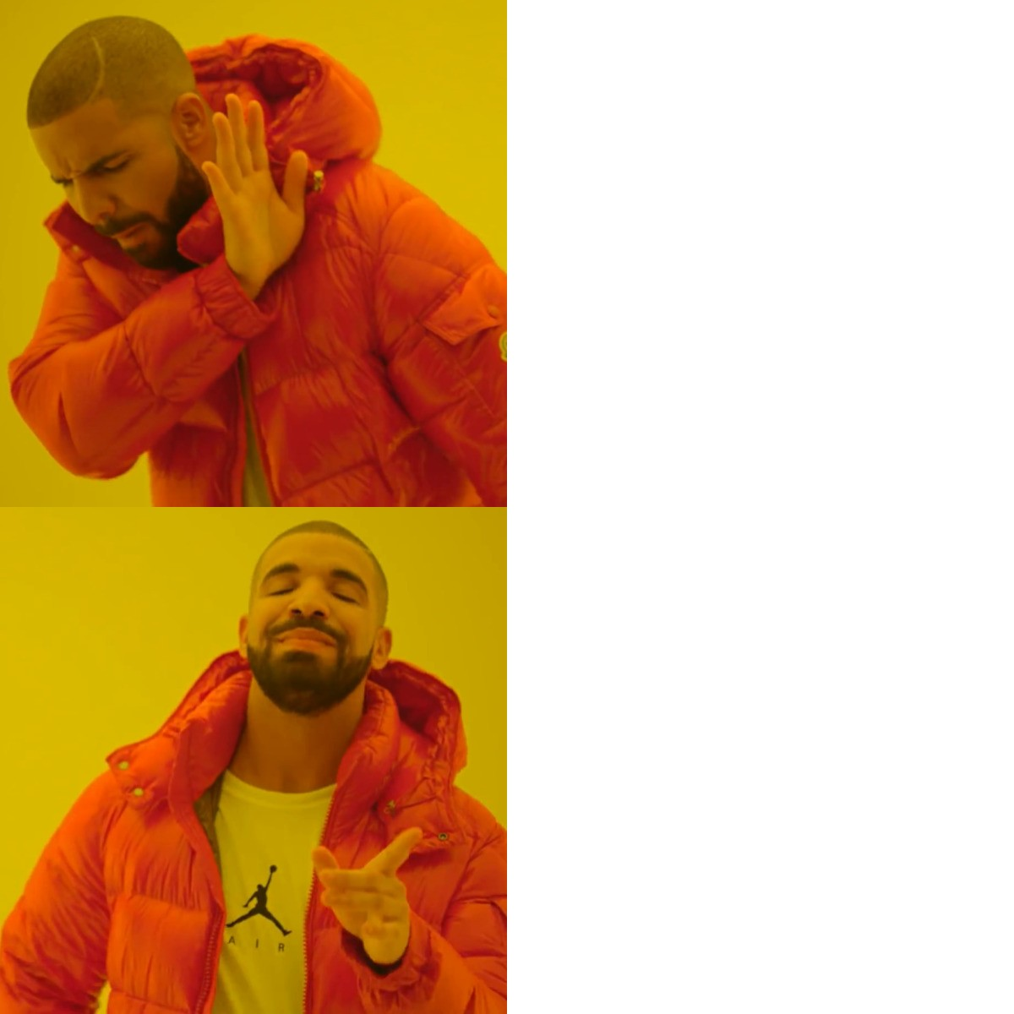
Coffee Break!
Extra help hours!
TIP FOR UNIVERSITY SUCCESS: Put in calendar, treat as a scheduled class, and bring one question you are confused about
Wednesday 1-3 PM
Office Hours
Coffee Break

Slide 4
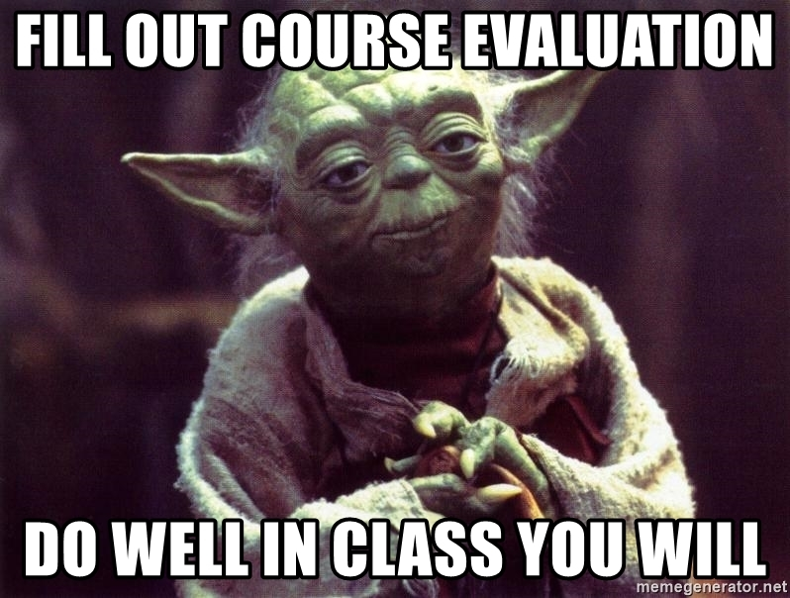
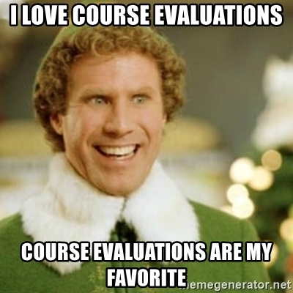
Course Evaluations
Extremely helpful! Every comment is read by your instructor and their department
You can help determine who teaches this course and how it’s taught in the future!
Please take the time to complete the course evaluation by June 20, 2024 (only takes 5 minutes)
Quercus ->Course Evals tab on left ->
https://q.utoronto.ca/courses/48756
Things we’ve changed:
No pre-labs
Lecture schedule changes (while loops before for loops, OOP before files)
More fun design problems

Slide 5
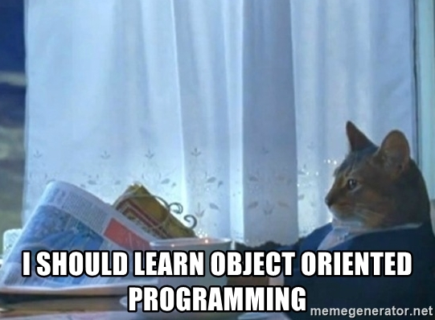
Why OOP?
Models our real-life thinking
Sandwich – ingredients, freshness, etc.
Car – model, year, fuel level, forward, reverse etc.
Movie – actors, director, genre, rating, etc.
Cat – weight, name, colour, scratch, meow, sleep, etc.
Why do we use it in programming?
Default values for a new object (initialization)
Properly set-up, predictable behaviours of different objects within the same class

Slide 6
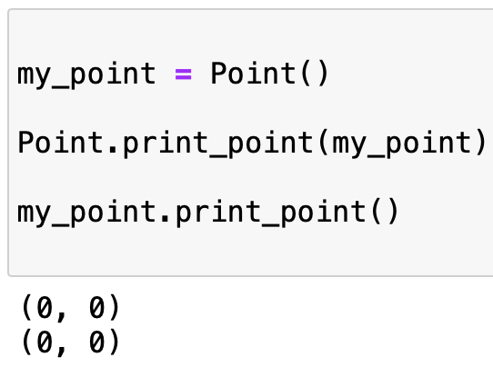
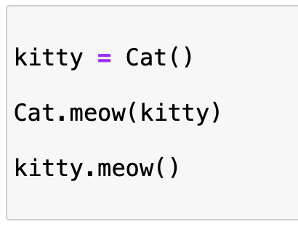

Why OOP?
The reason for this dot operator convention is an implicit metaphor:
The syntax for a function call, Cat.meow(kitty) suggests that the function is the active agent. It says something like, “Hey meow function from the Cat class! Here’s a Cat object (named kitty) for you to meow with.”
In OOP, the objects are the active agents. A method invocation like kitty.meow() says “Hey kitty! Please meow.”

Slide 7
Encapsulation
Encapsulation
seb.forward(50)
kitty.scratch()
The core of object-oriented programming is the organization of the program by encapsulating related data and functions together in an object.
To encapsulate something means to enclose it in some kind of container.
In programming, encapsulation means keeping data and the code that uses it in one place and hiding the details of exactly how they work together.
Class
Attributes
Methods

Slide 8
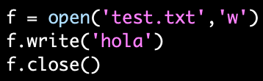
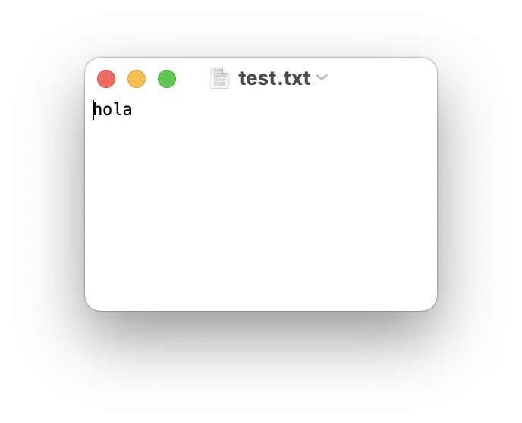
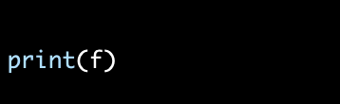
Encapsulate it!
For example, each instance of class file keeps track of which file on the disk it is reading/writing and where it currently is on that file.
The class hides the details of how it is done, so we (as programmers) can use it without needing to know how it is implemented

Slide 9
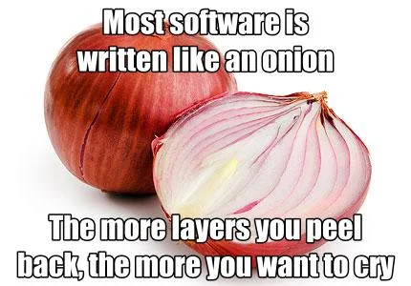
Let’s Code!
Let’s look at how this works in Python!
Point Class Recap
Rectangle Class
Open your notebook
Click Link:
1. Encapsulation

Slide 10
Printing Information
It would be nice to not have to write a print statement when we want to display attribute information:
Is there a better way to encapsulate this? How about a method?
>>> p = Point(3,4)
>>> print(p)
<__main__.Point object at 0x7fd8100778b0>
>>> p = Point(3,4)
>>> print(p.x, p.y)
3 4
>>> p = Point(3,4)
>>> p.to_string()
'(3,4)'
>>> r = p.halfway(Point(5,12))
>>> r.to_string()
'(4,8)'

Slide 11
Printing Information
If we had a method, we just need to format the attributes into a string:
We could make a similar method for any class (ex: Square)
class Point:
"""A class that represents and manipulates 2D points"""
def to_string(self):
"""
(self) -> None
Prints the (x, y) coordinate for the point.
"""
print('(' + str(self.x) + ', ' + str(self.y) + ')')
>>> p = Point(3,4)
>>> p.to_string()
'(3,4)'
>>> r = p.halfway(Point(5,12))
>>> r.to_string()
'(4,8)'

Slide 12
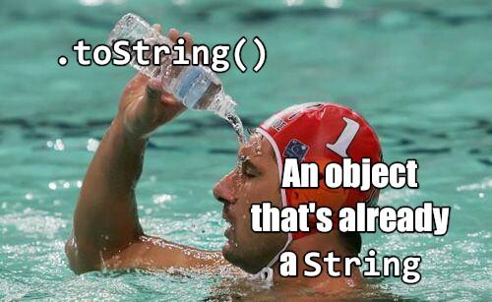
Printing Information
If every class we made had a to_string() method, great!
Easy to remember
All formatting specific to printing an object would be encapsulated
But they won’t all have one…
What if other people made their own method for printing and called it something else?
Then it would no longer be obvious how to quickly display information
Is it called to_string? tostring? 2stringz? print_point? plz_print_me?
Python has a clever trick for this!

Slide 13
Printing Information
If we call our new method __str__ instead of to_string, Python will use our code whenever it needs to convert Point to a string
class Point:
"""A class that represents and manipulates 2D points"""
def __init__(self, x=0 , y=0):
...
def __str__(self):
return (‘(’ + str(self.x) + ‘,’ + str(self.y) + ‘)’)
>>> p = Point(3,4)
>>> print(p)
'(3,4)'
That’s better!
When we call print(obj), then obj.__str__() is called to find out what string to print

Slide 14
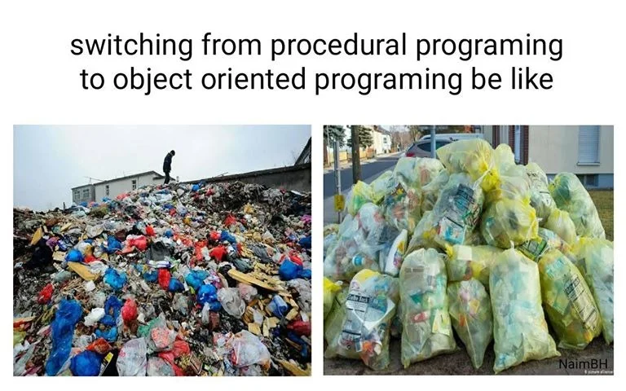
Let’s Code!
Let’s look at how this works in Python!
__str__ method
Open your notebook
Click Link:
2. Printing Objects

Slide 15





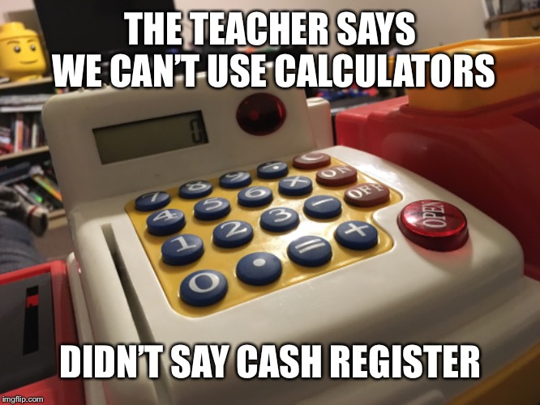
Let’s Build a Cash Register!
We want to build a cash register program. What features do we want?
Track number of:
Loonies
Toonies
$5 bills
$10 bills
$20 bills
Accepts cash
Removes cash
Calculates value of contents
Print the entire contents

Slide 16

Breakout Session!
Let’s look at how this works in Python!
Building a cash register
Attributes
Methods
Including __str__ method
Open your notebook
Click Link:
3. Building a Cash Register

Slide 17
More OOP! Encapsulation and Examples
Week 6 | Lecture 2 (6.2.1)

